Slide 1
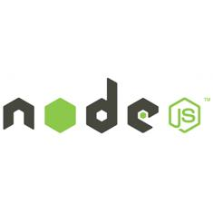

Intro to
CHC.js

Slide 2
Outline
Node and I (provide some context)
What is node?
Dev tool tips
Getting started with a simple node server
Sharing server and client code
Streams
Summary

Slide 3
Node and I
Heard about node around 2011/2012
Been playing with it and trying various things since.

Slide 4
Node and I
Hypermedia based applications (server and client)
Event driven (based on mediator pattern)
Hot swappable components (server and client)
*Never restart the server
*Never refresh the browser

Slide 5
Node and I
Node style modules in the browser
Like require.js but with commonjs modules
Intended to be only used for development
Browserify for production
Notes:
good way to learn about the module system

Slide 6
Node and I
Crowd sourced traffic flow information
Gathers information from a contributor
Location
Speed
Direction
Time
…
Build time ~ 4hrs

Slide 7
Node and I
Client work
RoadSafe Christchurch
Display some info pages
Registration / Login
Display various heat-maps and statistical data

Slide 8
Node and I
Forward works
Coordinate rebuild activities in Christchurch.
Find Clashes and Opportunities to:
reduce disruptions to road, water, and power networks
create city wide efficiencies

Slide 9
Node and I
Forward works
Api restification
Angular app server (with browserify)

Slide 10
Why node?
What problem is it trying to solve
Bit of history...

Slide 11
Why node? - History
How do you create a file upload progress bar?
Start file upload
ajax poll the server for progress

Slide 12
Why node? - History
Alternatives to short polling
Long polling
iframe with script tags
Keep the connection open and send script tags
Another form of long polling

Slide 13
Why node? - History
Implementing progress bars on the server
Most technologies required:
1 process per connection or
locked the process until the request was complete

Slide 14
Why node? - History
Tools like php treat servers as directories with files
Node was influenced by Mongrel which treated the basics of a server as a library to be built upon by the developer

Slide 15
Why node? - History
Javascript?
Ryan Dahl tried with
Ruby
Lua
Haskell
C (too low level)

Slide 16
Why node? - History
Javascript was chosen because
v8 had just been released
No one else was using javascript on the server
“No one had done it wrong”
Programming model was compatible with goals

Slide 17
Who is behind node?
Joyent sponsor node. Sell hosting not node
Microsoft
Open source community

Slide 18
Elevator Pitch
High performance interpreter
Non-blocking I/O. Blocking user land.
Javascript all the things
NPM awesomeness. Modularity for the win

Slide 19
Dev tool tips - Debugging
node inspector
winston

Slide 20
Dev tool tips - Testing
mocha
chai
replay
rewire

Slide 21
Dev tool tips - Version mgmt
nave (isaacs)
nodenv
nvm
n (visionmedia)

Slide 22
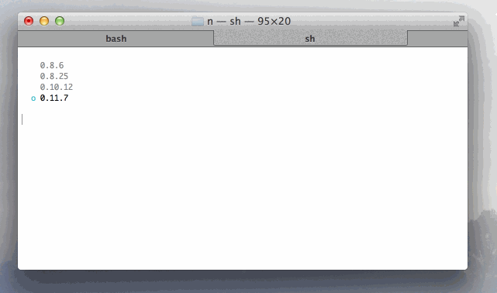

Slide 23
Dev tool tips - Misc
supervisor

Slide 24
Basic Server demo

Slide 25
Express server demo

Slide 26
Shared server/client code
YES
Notes:
examples from forward works
streams, http client, querystring, various npm modules

Slide 27
Streams
Data flows and transformations
Provide a common interface to:
Files,
Databases
WebSockets
Requests

Slide 28
Streams
Readable

Slide 29
Streams
Writeable

Slide 30
Streams
Read + Writeable

Slide 31
Streams
JSON stream demo

Slide 32
Summary

Slide 33
Questions?

